Slide 1

EMT Just In Time Training Modules, COVID-19
Techniques for Infection Prevention and Control

Slide 2

Session Outcomes
Outline the main considerations for decontamination of surfaces, linen and equipment in EMT work areas
Identify procedures for the rapid detection of infection amongst EMT staff
Apply effective hand hygiene practices in COVID treatment facilities or other clinical settings relevant to the EMT

Slide 3
Team Quiz - Rules
The quiz is based on your pre-learning
Questions are delivered centrally on slides. Each slide will be displayed for a timed period.
Aim to answer every question as a team. Discuss internally and try to involve all team members in formulating your answers.
The quiz is complete after all questions are covered.
Marks will be awarded at the trainer’s discretion!

Slide 4
1. List three of the five IPC strategies recommended by WHO for preventing or limiting the spread of COVID-19

Slide 5
2. Name two IPC administrative controls

Slide 6
3. List four elements of IPC standard precautions

Slide 7
4. Fill in the blanks on this chain of transmission diagram
?
?

Slide 8
5. What are the WHO 5 moments for hand hygiene?

Slide 9
6. List three ways that the EMT can promote respiratory hygiene in a health facility

Slide 10
7. Cleaning is listed as the first step in decontamination. List the other two steps available

Slide 11
8. List one commonly used hospital level disinfectant that is recommended for use in cleaning environmental surfaces to reduce the spread of COVID

Slide 12
9. True or false:
“Always clean from low areas to high areas, inner to outer”

Slide 13
10. State three considerations for managing used linen on patient wards in a COVID treatment facility

Slide 14
11. Name three IPC recommendations for consideration when setting up the triage area of an EMT facility

Slide 15
12. List two of the four conditions under which additional IPC precautions are recommended
(i.e. beyond the standard precautions)

Slide 16
13. What is the minimum flow rate for natural ventilation in the waiting room, triage area, mild and moderate wards?

Slide 17
14. What is the minimum distance between all beds of patients with respiratory illness?

Slide 18
15. Bonus Question: What are the actions that an EMT can take to promote rapid detection of infection amongst its team members?

Slide 19
Team Quiz - Answers
Please pass your answer sheet to the team next to you (clockwise).
Mark the paper as we go through the answers together – there is a prize!
Ask for clarification at any stage: the purpose is to establish a common baseline of knowledge across all team members

Slide 20
1. List three of the five IPC strategies recommended by WHO for preventing or limiting the spread of COVID-19

Slide 21
2. Name two IPC administrative controls

Slide 22
3. List four elements of IPC standard precautions

Slide 23
4. Fill in the blanks on this chain of transmission diagram
?
?

Slide 24
5. What are the WHO 5 moments for hand hygiene?

Slide 25
6. List three ways that the EMT can promote respiratory hygiene in a health facility

Slide 26
7. Cleaning is listed as the first step in decontamination. List the other two steps available

Slide 27
8. List one commonly used hospital level disinfectant that is recommended for use in cleaning environmental surfaces to reduce the spread of COVID
Answers may include:
Sodium hypochlorite 0.5%
Ethanol 70%
(Other answers are accepted at the trainer’s discretion)

Slide 28
9. True or false:
“Always clean from low areas to high areas, inner to outer”
FALSE

Slide 29
10. State three considerations for managing used linen on patient wards in a COVID treatment facility

Slide 30
11. Name three IPC recommendations for consideration when setting up the triage area of an EMT facility

Slide 31
12. List two of the four conditions under which additional IPC precautions are recommended
(i.e. beyond the standard precautions)

Slide 32
13. What is the minimum flow rate for natural ventilation in the waiting room, triage area, mild and moderate wards?
60 l/s/patient

Slide 33
14. What is the minimum distance between all beds of patients with respiratory illness?
1m apart

Slide 34
15. Bonus Question: What are the actions that an EMT can take to promote rapid detection of infection amongst its team members?
As for all safety issues, the EMT organisation has a Duty of Care responsibility for all team personnel. This applies whether they are co-located in the same facility or distributed across multiple work sites
Risk of infection to staff should be identified within the risk assessment process, and measures put in place to reduce either the likelihood (prevention) and/or consequences (mitigation) to levels tolerable for both the organisation and staff involved
Within this holistic framework, rapid detection is a mitigation measure that depends on active monitoring of COVID-19 signs/symptoms at three connected layers:
  The individual
  Other team members – e.g. recommend to introduce a buddy-buddy system
  The clinical shift team leader, or equivalent
Preparedness training and education on spotting the signs/symptoms at all three layers is crucial to rapid detection
A clear internal reporting system is also paramount, including consistent thresholds for WHEN reports are to be made, to WHOM, and HOW

Slide 35

Final Scores?
All EMT staff are recommended again to revisit the following e-module, available at: https://openwho.org/courses/COVID-19-IPC-EN/items/R6lz8D1kHocpj8TUlEM8r
Further technical guidance is available at: https://www.who.int/emergencies/diseases/novel-coronavirus-2019/technical-guidance/infection-prevention-and-control

Slide 36
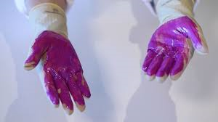
Hand Hygiene Practical

Slide 37
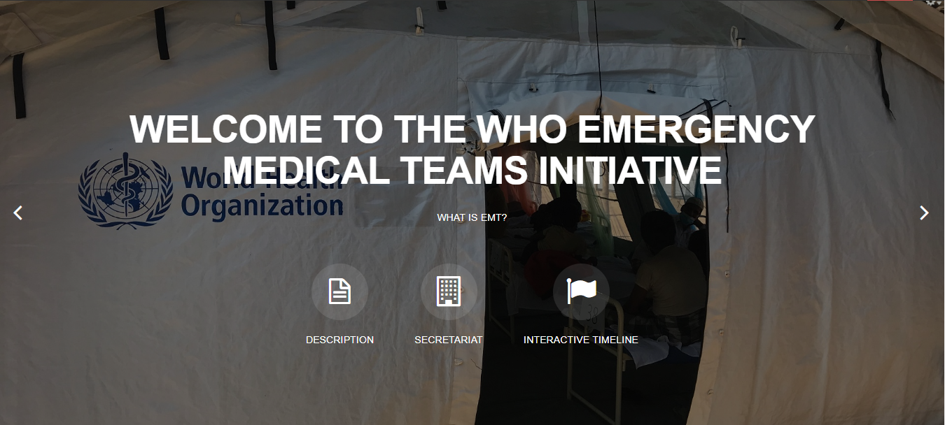
Thank you
Any questions?
For more…
http://extranet.who.int/emt/
EMTeams@who.int

